Slide 1
Levels of Abstraction
Physical level: describes how a record (e.g., instructor) is stored.
Logical level: describes data stored in database, and the relationships among the data.
  type instructor = record
  ID : string;
  name : string;
  dept_name : string;
  salary : integer;
        end;
View level: application programs hide details of data types. Views can also hide information (such as an employee’s salary) for security purposes.

Slide 2
Database Languages
Data Definition Language (DDL)
  Specification notation for defining the database schema
  E.g. create table account (account-number char(10),balance integer)
  DDL compiler generates a set of tables stored in a data dictionary
  Data dictionary contains metadata (i.e., data about data)
    Database schema
    Data storage and definition language
      language in which the storage structure and access methods used by the database system are specified
      Usually an extension of the data definition language

Slide 3
Data Manipulation Language (DML)
Language for accessing and manipulating the data organized by the appropriate data model
DML also known as query language
Two classes of languages
  Procedural – user specifies what data is required and how to get
  those data
  Nonprocedural – user specifies what data is required without
  specifying how to get those data
SQL is the most widely used query language

Slide 4
SQL (Structured Query language)
SQL: widely used non-procedural language
E.g. Find the name of the customer with customer-id 192-83-7465
  Select customer.customer-name from customer
  Where customer.customer-id = ‘192-83-7465’
E.g. Find the balances of all accounts held by the customer with customer-id 192-83-7465
  Select account.balance from depositor, account
  where
  depositor.customer-id = ‘192-83-7465’ and
  depositor.account-number = account.account-number
Application programs generally access databases through one of
  Language extensions to allow embedded SQL
  Application program interface (e.g. ODBC/JDBC) which allow SQL queries to be sent to a database
192-83-7465
select | account.balance
from | depositor, | account
where | depositor.customer-id = ‘192-83-7465’ and
select | customer.customer-name
from | customer
where | customer.customer-id = ‘192-83-7465’

Slide 5
Database Users
Users are differentiated by the way they expect to interact with the system
Application programmers – interact with system through DML calls.
Sophisticated users – form requests in a database query language.
Specialized users – write specialized database applications that do not fit into the traditional data processing framework.
Naïve users – invoke one of the permanent application programs that have been written previously.
E.g. people accessing database over the web, bank tellers, clerical staff

Slide 6
Database Administrator
Coordinates all the activities of the database system;
The database administrator has a good understanding of the enterprise’s information resources and needs.
Database administrator's duties include:
  Schema definition
  Storage structure and access method definition
  Schema and physical organization modification
  Granting user authority to access the database
  Specifying integrity constraints
  Acting as liaison with users
  Monitoring performance and responding to changes in requirements

Slide 7
Data Independence
Ability to modify a schema definition in one level without affecting a schema definition in the other levels.
The interfaces between the various levels and components should be well defined so that changes in some parts do not seriously influence others.
Two levels of data independence
Physical data independence
It is the ability to modify the physical scheme without causing application programs to be rewritten.
Modifications at the physical level are occasionally necessary in order to improve performance.
Logical data independence
It is the ability to modify the conceptual (logical) scheme without causing application programs to be rewritten.
Modifications at the conceptual level are necessary whenever the logical structure of the database is altered.

Slide 8
Instances and Schemas
Similar to types and variables in programming languages
Schema – the logical structure of the database
  E.g., the database consists of information about a set of customers and accounts and the relationship between them.
  Analogous to type information of a variable in a program
  Physical schema: database design at the physical level
  Logical schema: database design at the logical level
Instance – the actual content of the database at a particular point in time
  Analogous to the value of a variable

Slide 9
System Catalog (Data Dictionary)
Data dictionary is the repository of information describing the data in the database, that is the metadata or the “data about the data”.

Slide 10
Characteristics of Data Base Systems
Self-Describing Nature of a Database System
A fundamental characteristic of the database approach is that the database system contains not only the database itself but also a complete definition or description of the database structure and constraints.
This definition is stored in the DBMS catalog which is also called meta-data.

Slide 11
Characteristics of Data Base Systems
Insulation between Programs and Data, and Data Abstraction
In traditional file processing, the structure of data files is embedded in the application programs, so any changes to the structure of a file may require changing all programs that access that file.
By contrast, DBMS access programs do not require such changes in most cases.
The structure of data files is stored in the DBMS catalog separately from the access programs.
We call this property program-data independence.

Slide 12
Characteristics of Data Base Systems
Support of Multiple Views of the Data
A database typically has many users, each of whom may require a different perspective or view of the database.

Slide 13
Characteristics of Data Base Systems
Sharing of Data and Multiuser Transaction Processing
A multiuser DBMS must allow multiple users to access the database at the same time.
The DBMS must include concurrency control software to ensure that several users trying to update the same data do so in a controlled manner so that the result of the updates is correct.

Slide 14
Data Models
A collection of tools for describing
  data
  data relationships
  data semantics
  data constraints
It provides a way to describe the design of a database at a physical, logical &new level.

Slide 15
Types of Data Models
The Entity-Relationship Model
Relational Model
Network Data Model
Hierarchical Model

Slide 16
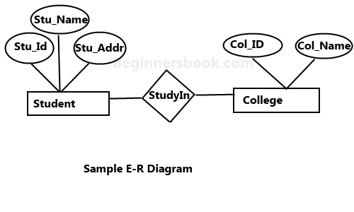
The Entity-Relationship Model

Slide 17
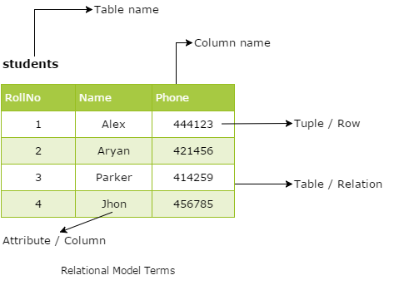
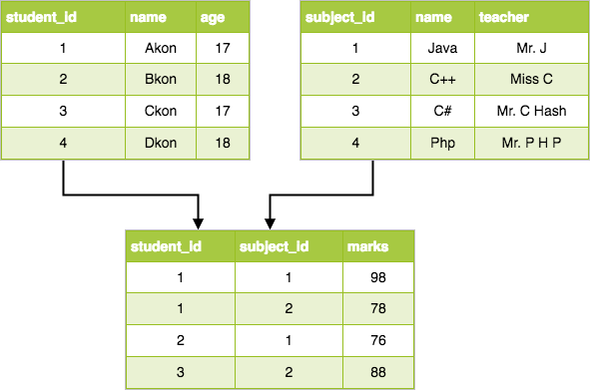
Relational Model

Slide 18
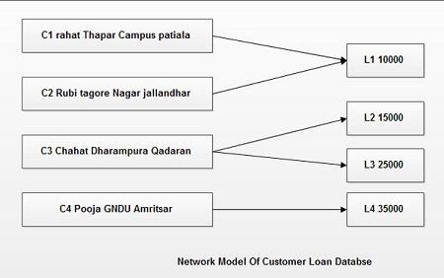
Network Data Model

Slide 19
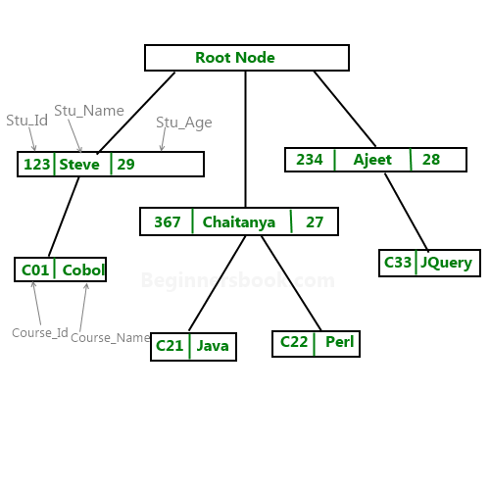
Hierarchical Model

Slide 20
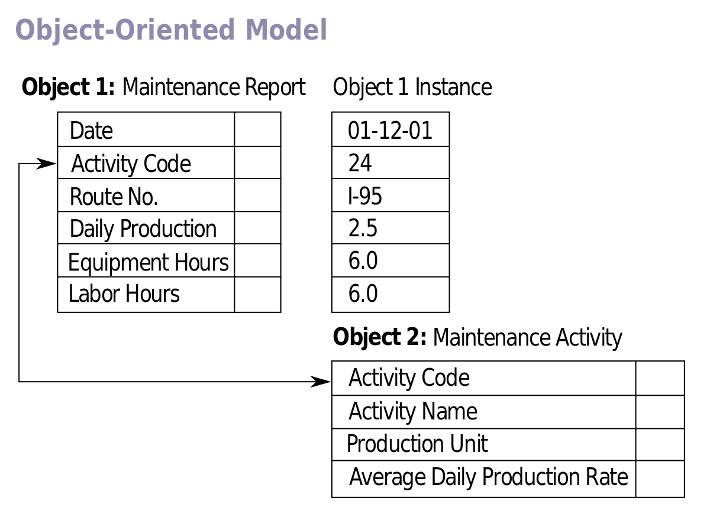
The object-oriented data model

Slide 21
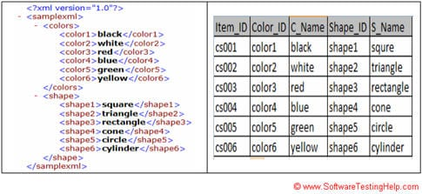
The eXtensible Markup Language (XML)

